Slide 1
Data Structure & Algorithms
Session 02
Linked List

Slide 2
Objectives
What is a linked list
Characteristics of Linked List
Linked List vs Array
Types of Linked List
Single Linked List Representation
Basic operations
Operations on Singly Linked List
Java LinkedList class

Slide 3
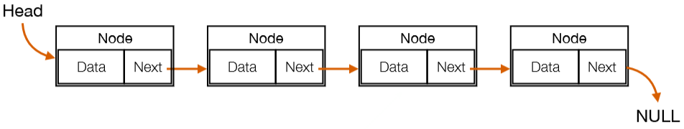



What is a linked list
A linked list is a sequence of data structures. It can be visualized as a chain of nodes, where every node points to the next node.
The following are the important points to be considered:
Link − Each link of a linked list can store a data called an element.
Next − Each link of a linked list contains a link to the next link called Next.
Linked List − A Linked List contains the connection link to the first link called First.

Slide 4
Characteristics of Linked List
Advantages:
They are a dynamic in nature which allocates the memory when required.
Insertion and deletion operations can be easily implemented.
In Linked List we don't need to know the size in advance.
Disadvantages:
The memory is wasted as pointers require extra memory for storage.
No element can be accessed randomly; it has to access each node sequentially.
Reverse Traversing is difficult in linked list.
Applications:
Linked List are used to implement stacks, queues, graphs, etc.
Linked List let you insert elements at the beginning and end of the list.

Slide 5
Linked List vs Array
Content | Array | Linked list
Size | Fixed size Need to specify the size when declaration an array | Size changes when adding / removing elements Maximum size depends on memory
Memory allocation | Static: Memory is allocated when compilation | Dynamic: Memory is allocated when running
Storing | Stored on a continuous range of memory cells | Stored on random memory cells
Accessing | Access to random elements directly by using array index: O (1) | Access to a random element needs to be browsed from start to finish: O (n)
Searching | Linear search or binary search | Only linear search is possible

Slide 6
Complexity
Data Structure | Time Complexity |  |  |  |  |  |  |  | Space Complexity
 | Average |  |  |  | Worst |  |  |  | Worst
 | Access | Search | Insertion | Deletion | Access | Search | Insertion | Deletion
Singly Linked List | θ(n) | θ(n) | θ(1) | θ(1) | O(n) | O(n) | O(1) | O(1) | O(n)

Slide 7
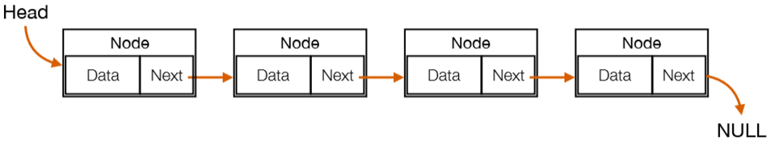
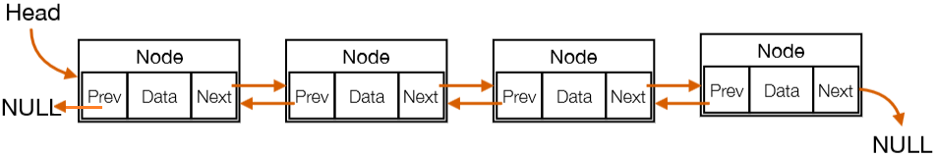
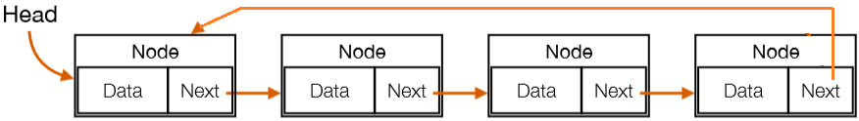
Types of Linked List
Following are the various types of linked list.
Simple Linked List − Item navigation is forward only.
Doubly Linked List − Items can be navigated forward and backward.
Circular Linked List − Last item contains link of the first element as next and the first element has a link to the last element as previous.

Slide 8
Representation of Singly Linked List
In Java, a Node and a Linked List can be represented as a class.
class linkedlist {
class node{
public int data;
public node next;
//constructor to create a new node, next is by default initialized as null
public node(int k){
data=k;
}
}
public node head;//head of list.
//define operations here
}

Slide 9
Basic Operations
Insertion: can be performed at different positions:
Insertion at beginning
Insertion at end of the list
Insertion after specified node
Deletion : can be performed at different positions.
Deletion at beginning
Deletion at the end of the list
Deletion specified node
Notes:
There are various operations which can be performed on linked list:

Slide 10
Basic Operations
Traversing: we simply visit each node of the list at least once in order to perform some specific operation on it.
Searching: we match each element of the list with the given element, if found that element is returned, otherwise null is returned.

Slide 11
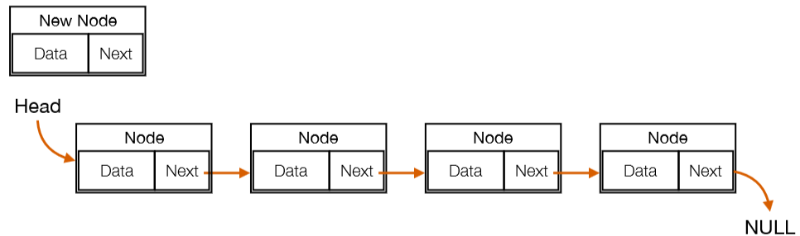
Operations on Singly Linked List
Insertion at beginning:
First, we need to create a new node

Slide 12
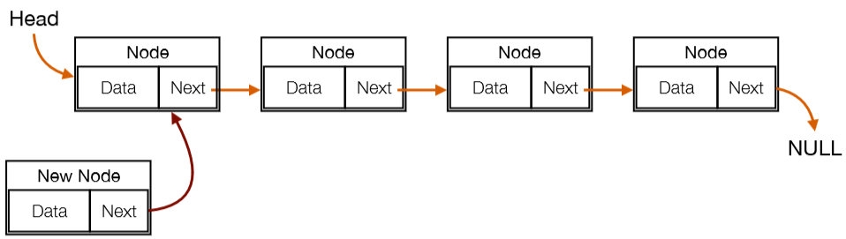
Operations on Singly Linked List
Insertion at beginning:
Next, we assign Next of new node to Head

Slide 13
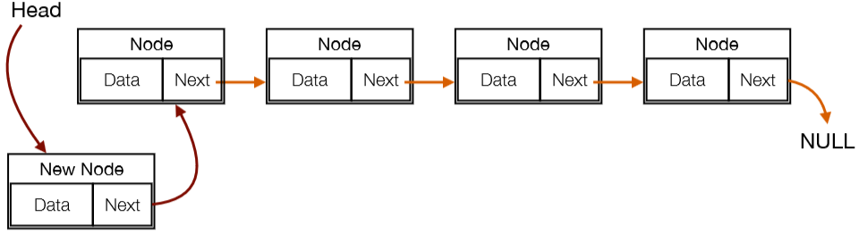
Operations on Singly Linked List
Insertion at beginning:
Final, we assign Head to new node .

Slide 14
Operations on Singly Linked List
Insertion at beginning:
public void insertHead(int x)
{
// Create a new node
node n=new node(x);
// If the List is empty, we assign head to new node
if(head==null)
head=n;
else
{
n.next=head;
head=n;
}
}

Slide 15
Operations on Singly Linked List
Insertion at end of the list:
First, we need to create a new node

Slide 16
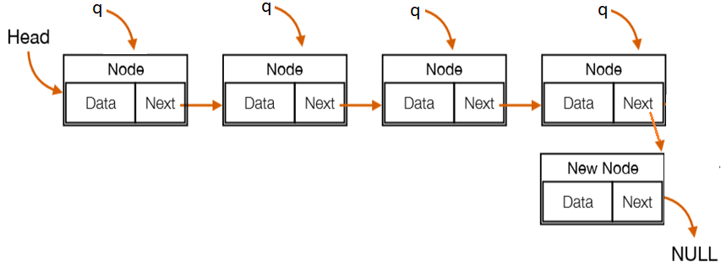
Operations on Singly Linked List
Insertion at end of the list:
Next, we traverse the list from the beginning until the end.
Final, we assign Next of last Node to new Node

Slide 17
Operations on Singly Linked List
Insertion at end of the list:
public void insertLast(int x) {
node n=new node(x);//create a new node
//if the list is empty, we assign head to new node
if(head==null)head=n;
else
{ //start at the beginning
node q=head;
//traverse to last node
while(q.next!=null) q=q.next ;
q.next=n; //assign next of last node to new node
}
}

Slide 18
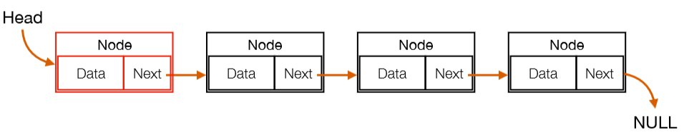
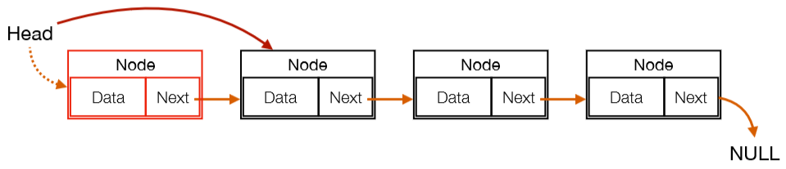
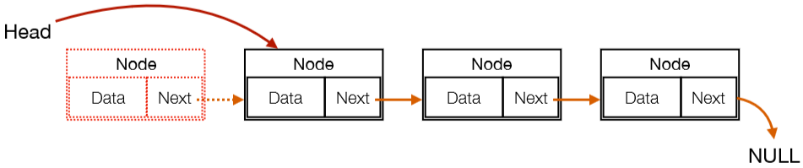
Operations on Singly Linked List
Deletion at beginning:
First, we assign Head to Next node of Head.
Final, we delete node of Head.

Slide 19
Operations on Singly Linked List
Deletion at beginning:
public linkedlist deleteHead()
{
if(head!=null)//if list is not empty
{
head=head.next;
}
return this;
}

Slide 20
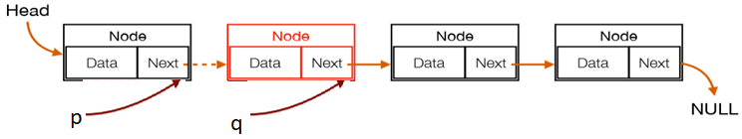
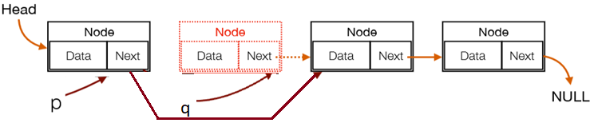
Operations on Singly Linked List
Deletion specified node: is also a more than one step process.
First, we locate the target node q to be removed by using searching algorithms. While we locate node q, we need to hold node p is previous node of q.
Next, we assign Next of p to Next node of q.
Final, we delete node q.

Slide 21
Operations on Singly Linked List
Deletion specified node:
public linkedlist deleteKey(int k) {
if(head!=null) {//if list is not empty
if(head.data==k) return deleteHead(); //if k is at head then call deleteHead()
node q=head, node p=head; //Start at the beginning
while(q!=null) {
if(q.data==k) {//if found k need to be deleted
p.next=q.next;
System.out.println(k + " da bi xoa");
break;
}
else {
p=q;
q=q.next;
}
}
if(q==null) System.out.println(k+" khong co trong danh sach!");
}
return this;
}

Slide 22
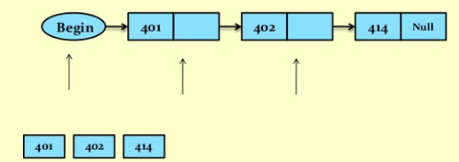
Operations on Singly Linked List
Traversing:
Start at the beginning
Go on node at a time until the end.

Slide 23
Operations on Singly Linked List
Traversing:
public void traversing()
{
node q=head;//Start at the beginning
System.out.print("[ ");
while(q!=null) // Traverse through the LinkedList
{ // Print the data at current node
System.out.print(q.data+" ");
// Go to next node
q=q.next;
}
System.out.println("]");
}

Slide 24
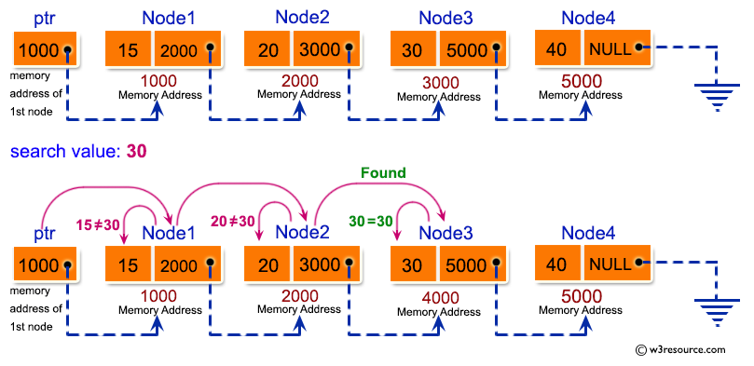
Operations on Singly Linked List
Searching:
Start at the beginning
Go on node at a time, compare “node value” to “search key” till element being searched for found or end of the list.

Slide 25
Operations on Singly Linked List
Searching:
public boolean searching(int data)
{
node q=head; ;//Start at the beginning
while(q!=null) // Traverse through the LinkedList
{ //if found
if(data==q.data)return true;
// Go to next node
q=q.next;
}
return false;
}

Slide 26
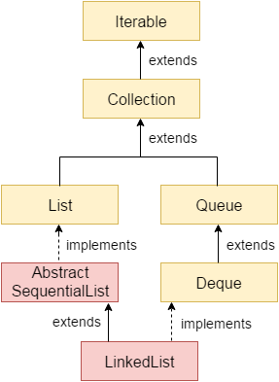
Java LinkedList class
Java LinkedList class uses a doubly linked list to store the elements.
The important points about Java LinkedList are:
contains duplicate elements.
maintains insertion order.
non synchronized.
manipulation is fast because no shifting needs to occur.
it can be used as a list, stack or queue.

Slide 27
Java LinkedList class
Constructors of Java LinkedList
Constructor | Description
LinkedList() | It is used to construct an empty list.
LinkedList (Collection<?> c) | It is used to construct a list from the specified collection.

Slide 28
Java LinkedList class
Some commonly used methods of Java LinkedList
Method | Description
boolean add(E e) | Append the specified element to the end
void add(int index, E element) | Insert the specified element at the specified position index.
void addFirst(E e) | Insert the given element at the beginning.
void addLast(E e) | Append the given element to the end.
void clear() | remove all the elements from a list.
boolean contains( Object o) | return true if a list contains a specified element and opposite
int size() | return the number of elements.

Slide 29
Java LinkedList class
Some commonly used methods of Java LinkedList
Method | Description
E getFirst() | return the first element
E getLast() | return the last element
int indexOf( Object o) | return the index in a list of the first occurrence of the specified element and opposite return -1
int lastIndexOf( Object o) | return the index in a list of the last occurrence of the specified element and opposite return -1
E remove() | retrieve and removes the first element
boolean remove(Object o) | remove the first occurrence of the specified element
E removeFirst() | Remove and returns the first element
E removeLast() | Remove and returns the last element

Slide 30
Java LinkedList class
Some commonly used methods of Java LinkedList
Method | Description
E peek() | It retrieves the first element of a list
E peekFirst() | It retrieves the first element of a list or returns null if a list is empty.
E peekLast() | It retrieves the last element of a list or returns null if a list is empty.
E poll() | It retrieves and removes the first element
E pollFirst() | It retrieves and removes the first element of a list, or returns null if a list is empty.
E pollLast() | It retrieves and removes the last element of a list, or returns null if a list is empty.
E pop() | It pops an element from the stack represented by a list.
void push(E e) | It pushes an element onto the stack represented by a list.

Slide 31
Java LinkedList class examlpe 1
import java.util.*;
public class Test {
public static void main(String args[]) {
// Creating object of class linked list
LinkedList<String> object = new LinkedList<String>();
// Adding elements to the linked list
object.add("A"); object.add("B"); object.addLast("C");
object.addFirst("D"); object.add(2, "E"); object.add("F"); object.add("G");
System.out.println("Linked list : " + object);
// Removing elements from the linked list
object.remove("B"); object.remove(3);
object.removeFirst(); object.removeLast();
System.out.println("Linked list after deletion: " + object);

Slide 32
Java LinkedList class examlpe 1
boolean status = object.contains("E"); // Finding elements in the linked list
if(status) ystem.out.println("List contains the element 'E' ");
else System.out.println("List doesn't contain the element 'E'");
int size = object.size(); // Number of elements in the linked list
System.out.println("Size of linked list = " + size);
Object element = object.get(2); // Get and set elements from linked list
System.out.println("Element returned by get() : " + element);
object.set(2, "Y");
System.out.println("Linked list after change : " + object);
}
}
Output:
Linked list : [D, A, E, B, C, F, G]
Linked list after deletion: [A, E, F]
List contains the element 'E'
Size of linked list = 3
Element returned by get() : F
Linked list after change : [A, E, Y]

Slide 33
Java LinkedList class examlpe 2
import java.util.LinkedList;
import java.util.List;
class Student {
private int id;
private String name;
public Student(int id, String name) {
this.id = id;
this.name = name;
}
public void output() {
System.out.println("Student [id=" + id + ", name=" + name + "]“);
}
}

Slide 34
Java LinkedList class examlpe 2
public class LinkedListExample {
public static final int NUM_OF_ELEMENT = 5;
public static void main(String[] args) {
// Create list
LinkedList <Student> students = new LinkedList<Student>();
for (int i = 1; i <= NUM_OF_ELEMENT; i++) {
// Add element to list
Student student = new Student(i, "myname" + i);
students.add(student);
}
// Show list student
for (Student student : students) {
student.output();
}
}
}
Output:
Student [id=1, name=myname1]
Student [id=2, name=myname2]
Student [id=3, name=myname3]
Student [id=4, name=myname4]
Student [id=5, name=myname5]

Slide 35
Summary
A linked list is a sequence of data structures, which are connected together via links.
Linked List is a sequence of links which contains items. Each link contains a connection to another link. Linked list is the second most-used data structure after array
Size changes when adding / removing elements Maximum size depends on memory.
Stored on random memory cells and memory is allocated when running.
Java LinkedList class uses a doubly linked list to store the elements. It provides a linked-list data structure.

Slide 36
References
https://www.tutorialspoint.com/data_structures_algorithms/linked_list_algorithms.htm
https://vi.wikipedia.org/wiki/Danh_s%C3%A1ch_li%C3%AAn_k%E1%BA%BFt
https://www.javatpoint.com/singly-linked-list
https://www.geeksforgeeks.org/implementing-a-linked-list-in-java-using-class/
https://gpcoder.com/2555-linkedlist-trong-java/
https://www.javatpoint.com/java-linkedlist
https://www.geeksforgeeks.org/linked-list-in-java/

Slide 37


